Slide 1

D.Eco Application
Presented by Code Monkey

Slide 2

Sprint 1 Transition
Application Demo
Acceptance testing
Design Choices
Plan for Sprint 2
Code Monkey
April 5, 2017

Slide 3
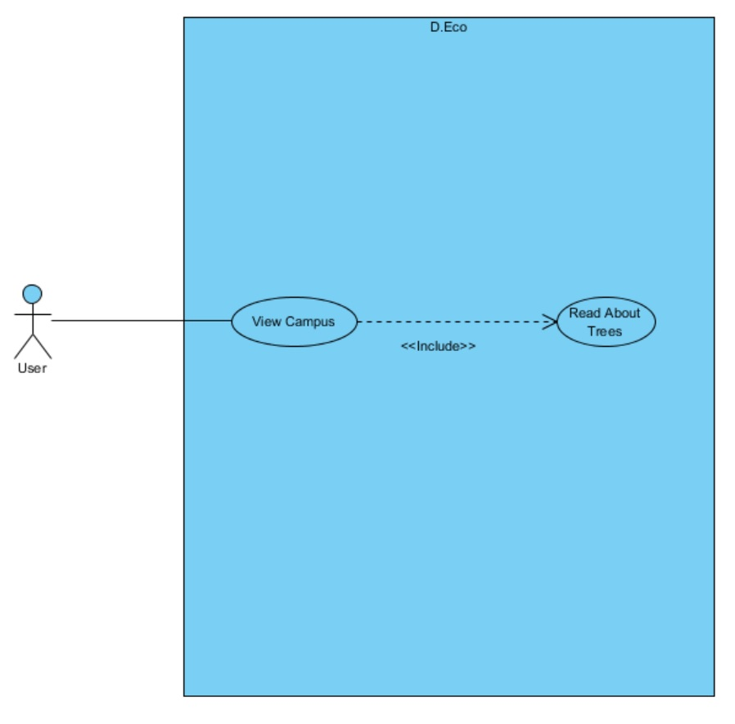
Acceptance Plan

Slide 4
Acceptance Plan
Requirement | Description | Acceptance
View Campus | A user looks at the campus map, which displays a satellite view or standard view of campus, with pins for each tree | The User was able to view both the standard and satellite view of the campus on a map, with interactive pins
Read about Trees | A User reads detailed information (species, paragraph about, in honor of person) about the specific tree clicked on the map | The User, when pressing a pin for a a tree, was displayed a brief description about the tree

Slide 5
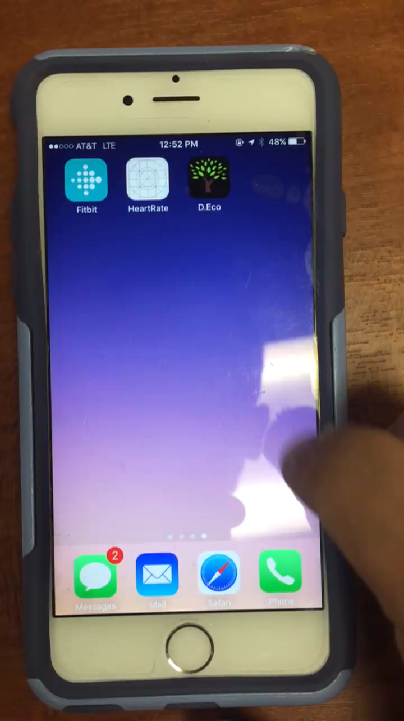
Demonstration
Code Monkey
May 4, 2017

Slide 6
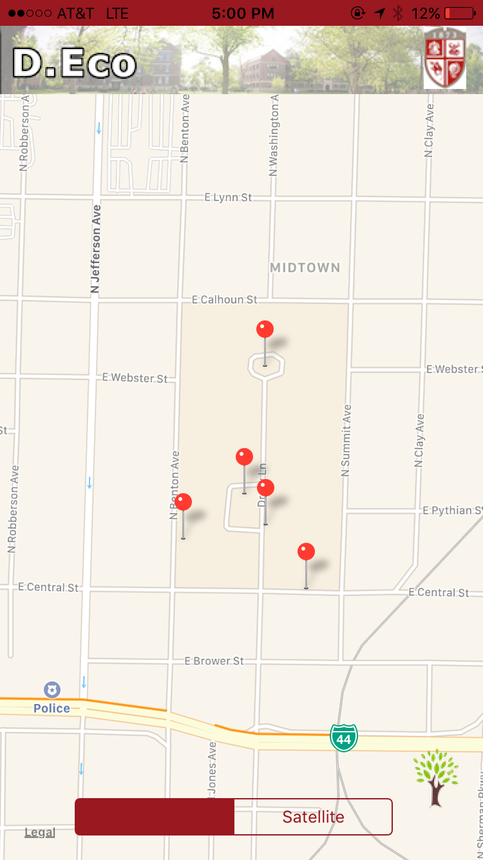
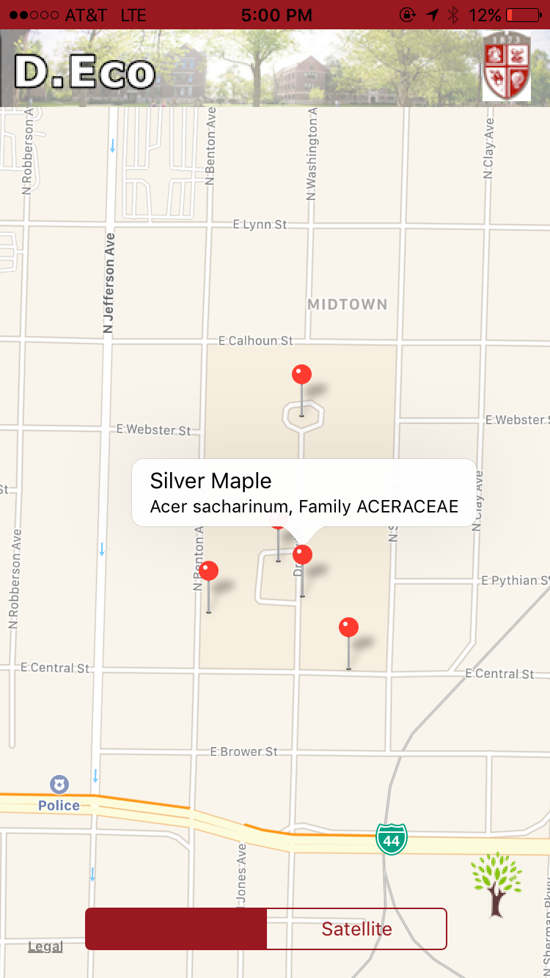
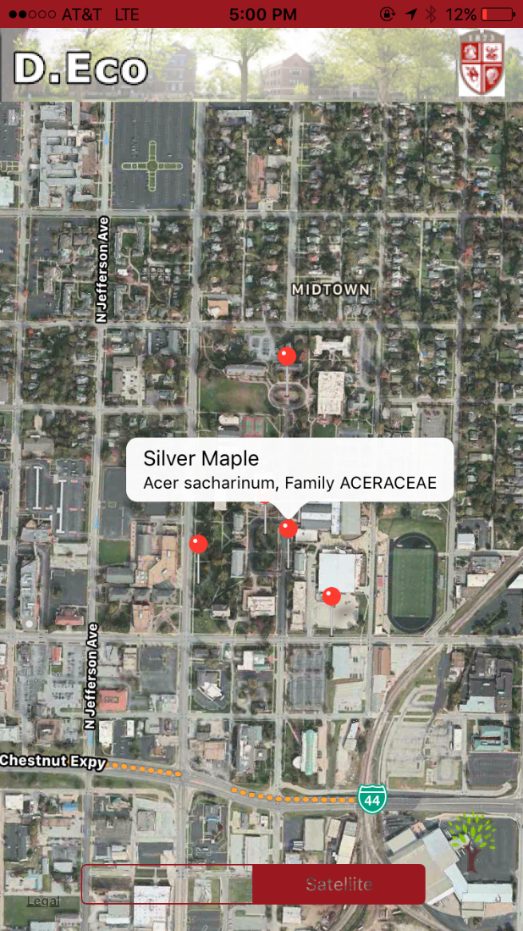
Demonstration
Code Monkey
May 4, 2017

Slide 7
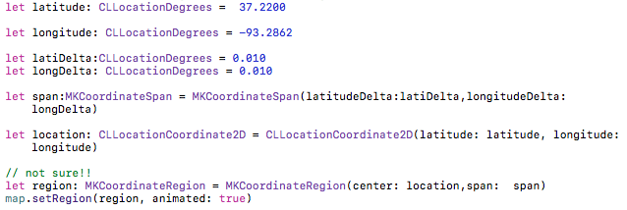
Create Map

Slide 8
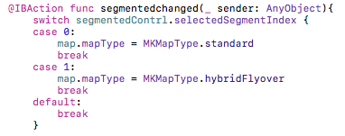
Map Style
Segmented control

Slide 9
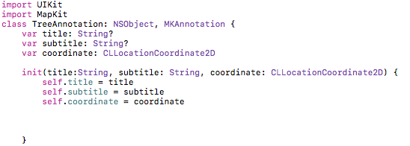
Annotation Class

Slide 10
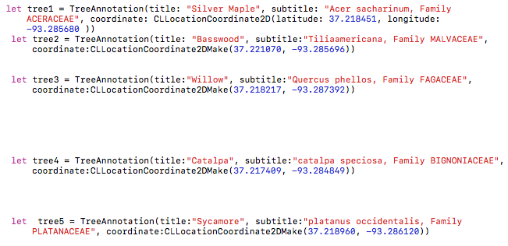
Create Annotation

Slide 11
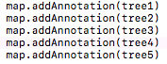
Add Annotations To Map

Slide 12
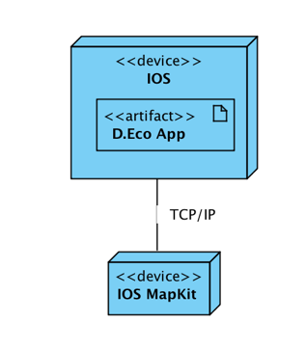
Design Choices
iOS single view app
Swift
MapKit

Slide 13
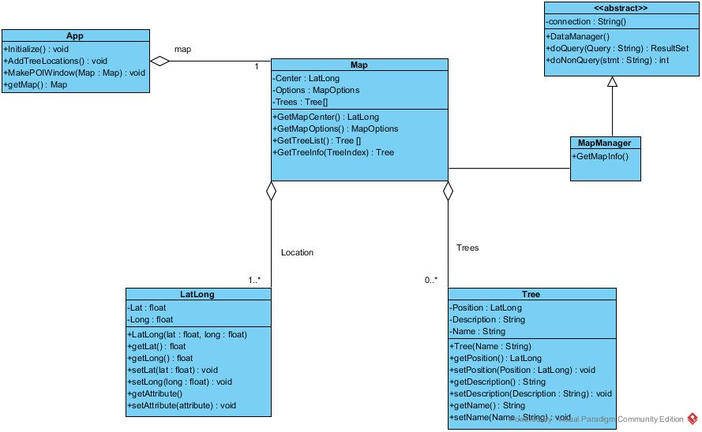
Sprint 2 Plan – Class Diagram

Slide 14
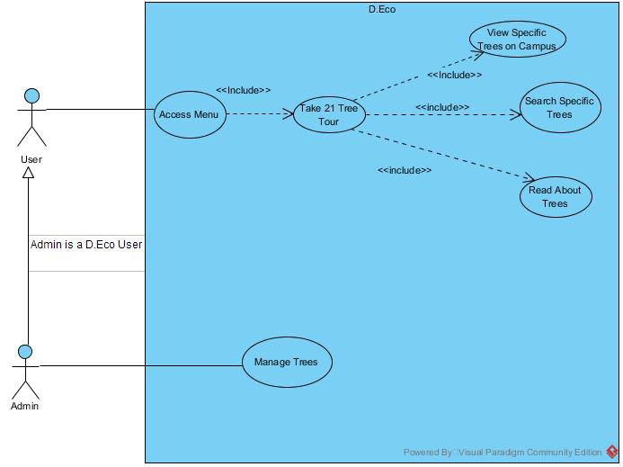
Sprint 2 Plan – Use Case

Slide 15
Plan – Sprint 2
What | Who | When
Requirements (Update Use Case) | Kylie | Sept. 1
Analysis (Update cost, risk & effort estimate) | Cyler and Morgan | Sept. 4
Design (Platforms & Architecture) | Cory and Fisal | Sept. 4
Android version (Catch up to IOS) | Cory and Cyler | Sept. 8

